Slide 1

May 2018
Bangalore
Types of Probablity Distribution,T-test,Z-test

Slide 2
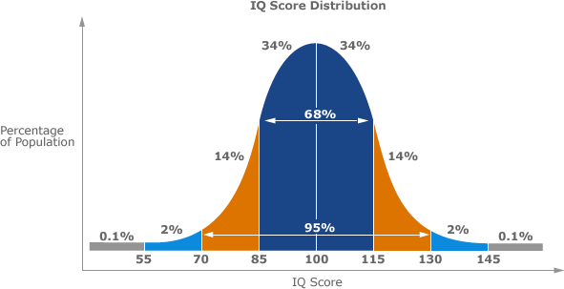
Random Variable
➢ A random variable describes the probability of an uncertain future numerical outcome of a random process.
➢ It is random because there is some change associated with each possible value.
➢ All random variables have three aspects:
• A Distribution
• A Mean
• A Standard Deviation

Slide 3
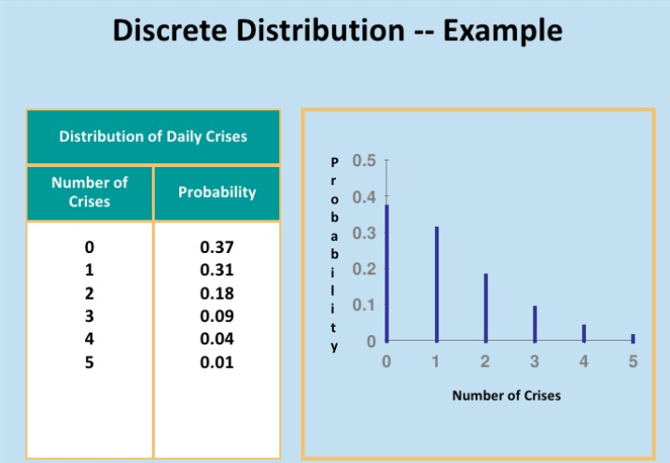
Distribution
➢ A probability distribution is a rule that identifies possible outcomes of a random variables and assigns a probability to
each.
➢ A discrete distribution has a finite number of values, for example, Price of coke, age of employees, etc.
➢ A continuous distribution has all possible values in some range, for example, sales per week, weight of students, etc.

Slide 4
➢ If a random variable is a discrete variable then its probability distribution is called a discrete probability distribution.
➢ Any random variable is called discrete random variable which is the part of discrete distribution.
➢ A random variable can take two types of values either,
• Fix numbers that is discrete values or
• Range that is continuous type of values
➢ In continuous type data, the values can lie anywhere within the specified range.
➢ The most common applications of discrete probability distribution are:
• Binomial Distribution
• Poisson Distribution
• Geometric Distribution
• Bernoulli Distribution

Slide 5

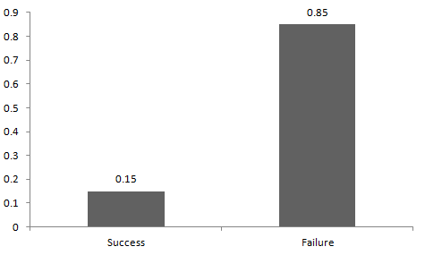
Bernoulli Distribution
Let’s start with the easiest distribution that is Bernoulli Distribution. It is actually easier to understand than it sounds!
All you cricket junkies out there! At the beginning of any cricket match, how do you decide who is going to bat or ball? A toss! It all depends on whether you win or lose the toss, right? Let’s say if the toss results in a head, you win. Else, you lose. There’s no midway.
A Bernoulli distribution has only two possible outcomes, namely 1 (success) and 0 (failure), and a single trial. So the random variable X which has a Bernoulli distribution can take value 1 with the probability of success, say p, and the value 0 with the probability of failure, say q or 1-p.
Here, the occurrence of a head denotes success, and the occurrence of a tail denotes failure. Probability of getting a head = 0.5 = Probability of getting a tail since there are only two possible outcomes.
The probability mass function is given by: p^{x}(1-p)^{1-x} where x € (0, 1). It can also be written as
The probabilities of success and failure need not be equally likely, like the result of a fight between me and Undertaker. He is pretty much certain to win. So in this case probability of my success is 0.15 while my failure is 0.85.

Slide 6

Binomial Distribution
Suppose that you won the toss today and this indicates a successful event. You toss again but you lost this time. If you win a toss today, this does not necessitate that you will win the toss tomorrow. Let’s assign a random variable, say X, to the number of times you won the toss. What can be the possible value of X?
It can be any number depending on the number of times you tossed a coin.
There are only two possible outcomes. Head denoting success and tail denoting failure.
Therefore, probability of getting a head = 0.5 and the probability of failure can be easily computed as: q = 1- p = 0.5.
A distribution where only two outcomes are possible, such as success or failure, gain or loss, win or lose and where the probability of success and failure is same for all the trials is called a Binomial Distribution.
The outcomes need not be equally likely. Remember the example of a fight between me and Undertaker?
So, if the probability of success in an experiment is 0.2 then the probability of failure can be easily computed as q = 1 – 0.2 = 0.8.
Each trial is independent since the outcome of the previous toss doesn’t determine or affect the outcome of the current toss. An experiment with only two possible outcomes repeated n number of times is called binomial. The parameters of a binomial distribution are n and p where n is the total number of trials and p is the probability of success in each trial.
On the basis of the above explanation, the properties of a Binomial Distribution are
1.Each trial is independent.
There are only two possible outcomes in a trial- either a success or a failure.
A total number of n identical trials are conducted.
The probability of success and failure is same for all trials. (Trials are identical.)
The mathematical representation of binomial distribution is given by:

Slide 7
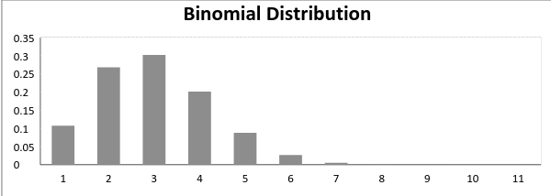
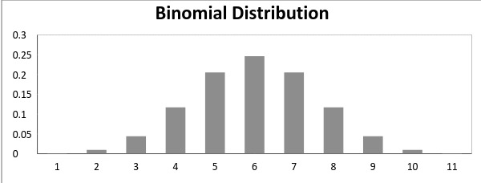
A binomial distribution graph where the probability of success does not equal the probability of failure looks like
Now, when probability of success = probability of failure, in such a situation the graph of binomial distribution looks like

Slide 8
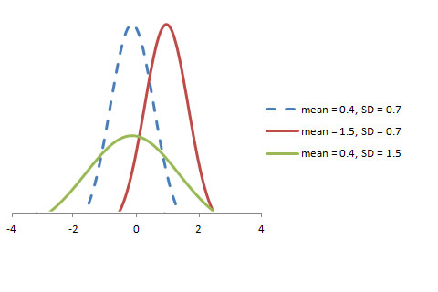
Normal distribution represents the behavior of most of the situations in the universe (That is why it’s called a “normal” distribution. I guess!). The large sum of (small) random variables often turns out to be normally distributed, contributing to its widespread application. Any distribution is known as Normal distribution if it has the following characteristics:
The mean, median and mode of the distribution coincide.
The curve of the distribution is bell-shaped and symmetrical about the line x=μ.
The total area under the curve is 1.
Exactly half of the values are to the left of the center and the other half to the right.
A normal distribution is highly different from Binomial Distribution. However, if the number of trials approaches infinity then the shapes will be quite similar.

Slide 9
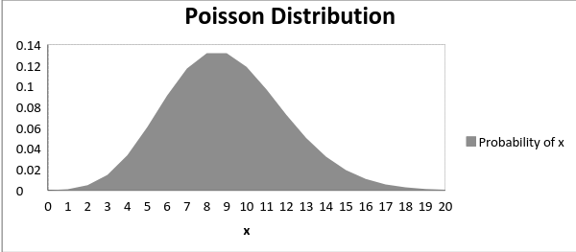
A distribution is called Poisson distribution when the following assumptions are valid:
1. Any successful event should not influence the outcome of another successful event. 2. The probability of success over a short interval must equal the probability of success over a longer interval. 3. The probability of success in an interval approaches zero as the interval becomes smaller.
Now, if any distribution validates the above assumptions then it is a Poisson distribution. Some notations used in Poisson distribution are:
λ is the rate at which an event occurs,
t is the length of a time interval,
And X is the number of events in that time interval.

Slide 10
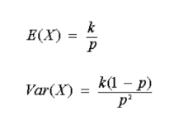
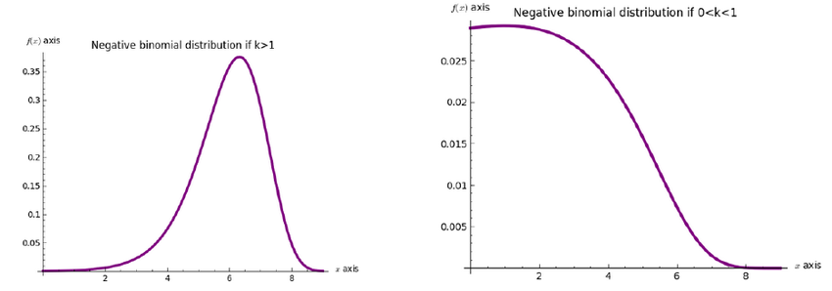
Negative Binomial Distribution
➢ Consider a statistical experiment where a success occurs with probability p.
➢ If the experiment is repeated indefinitely and the trials are independent of each other, then the random variable X,
whose value is the number of the trial on which the rth success occurs, has a negative binomial distribution with
parameters r and p.
➢ Mean and variance of negative binomial distribution is defined as,

Slide 11
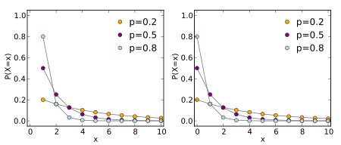
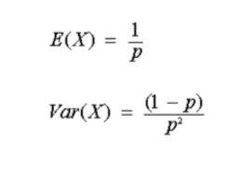
Geometric Distribution
➢ A Geometric random variable is the number of trials required to obtain the first success.
➢ A discrete random variable ‘X’ is said to follow a Geometric distribution with parameter ‘p’, if it has a probability
distribution.
➢ Mean and variance of geometric distribution is defined as,

Slide 12
Geometric Distribution
Geometric Distribution Requirements
The trials must meet the following requirements:
➢ The total number of trials is potentially infinite
➢ There are just two outcomes of each trial; Success and Failure
➢ The outcomes of all the trials are statistically independent
➢ All the trials have the same probability of success

